Slide 1
Model Optimization
Linden Lu

Slide 2
Module 5: Model Optimization
Feature Selection
Cross Validation
Model Selection

Slide 3
Introduction to Feature Selection
Linden Lu

Slide 4
Lesson 1: Feature Selection
Key benefits
Reduces Overfitting
Improves Accuracy
Reduces Training Time
Improves Interpretability

Slide 5
Feature selection algorithms
Filter methods
Wrapper methods
Embedded methods

Slide 6
Filter Methods
Variance Threshold
Rank features by variance
Feature Scaling is necessary
Doesn't use target feature
Univariate Techniques
Rate features individually
Relationship between individual feature and target feature

Slide 7
Wrapper methods
Recursive Feature Extraction

Slide 8
Embedded Methods
Rank features during training
Model dependent
Decision Tree
Random Forest

Slide 9
Introduction to Cross Validation
Linden Lu

Slide 10
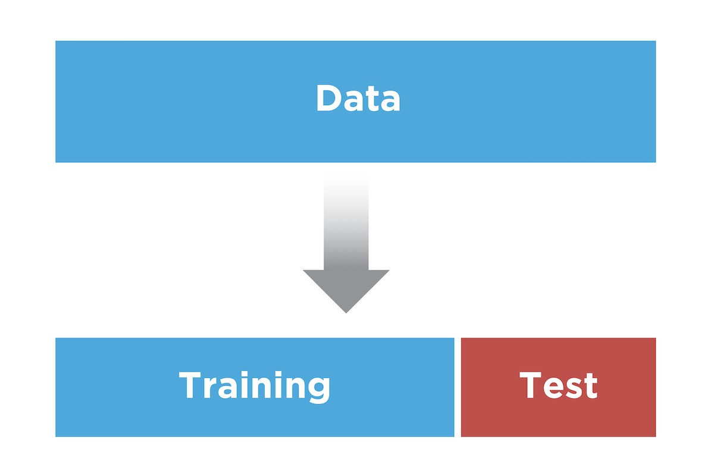
Dataset Splitting

Slide 11
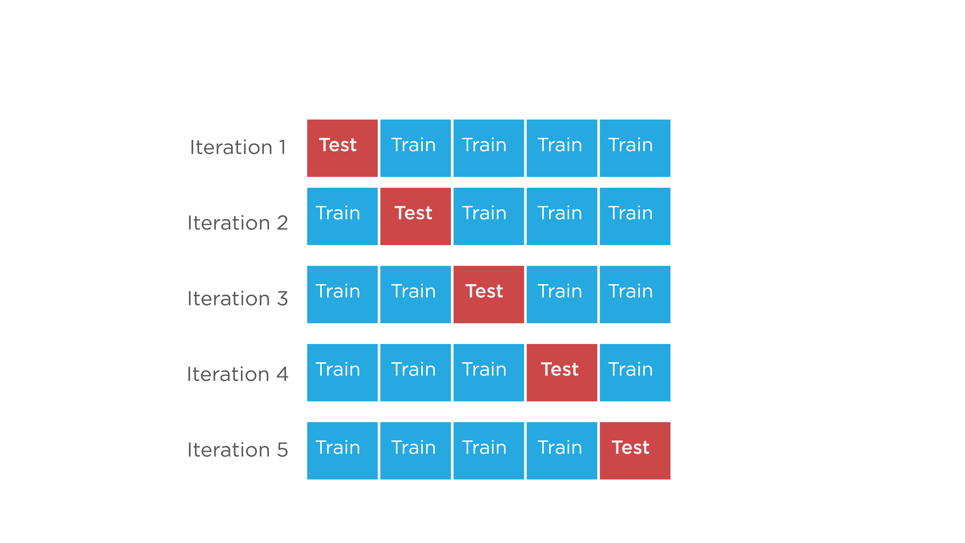
KFold Cross Validation

Slide 12
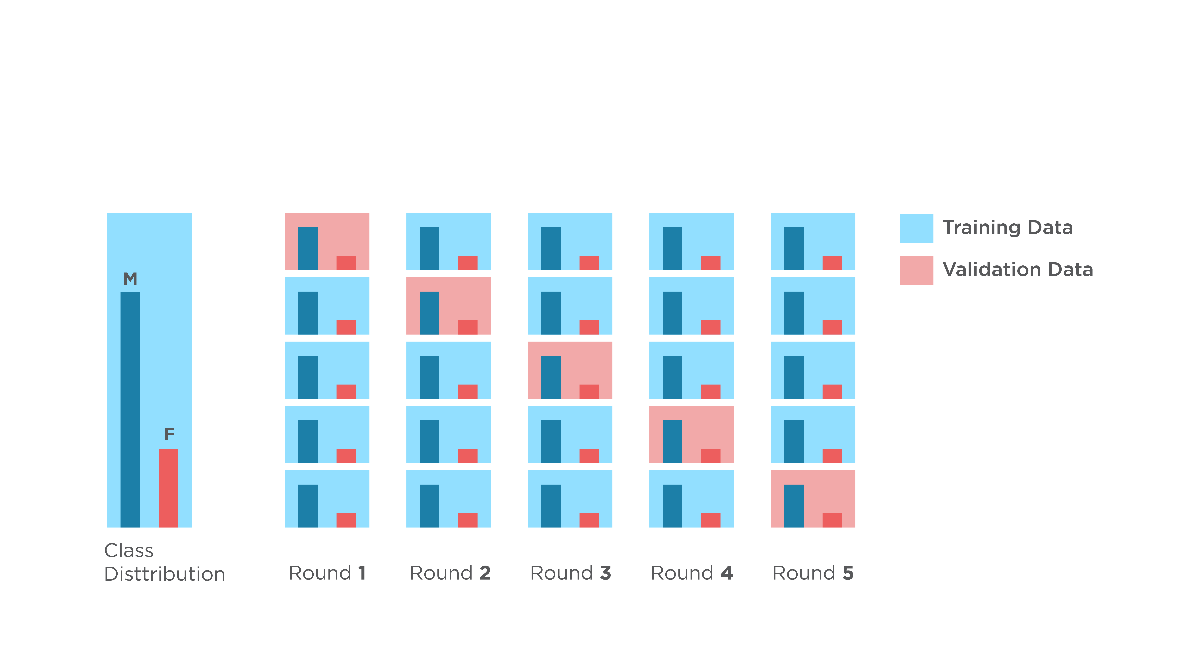
Stratified KFold

Slide 13
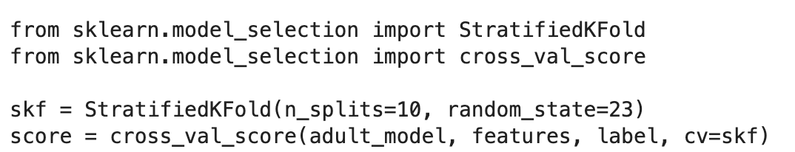
Evaluate Model with Cross-Validation

Slide 14
Custom Scoring

Slide 15
Introduction to Model Selection
Linden Lu

Slide 16
Model Selection with Cross Validation
Grid Search
Random Grid Search

Slide 17
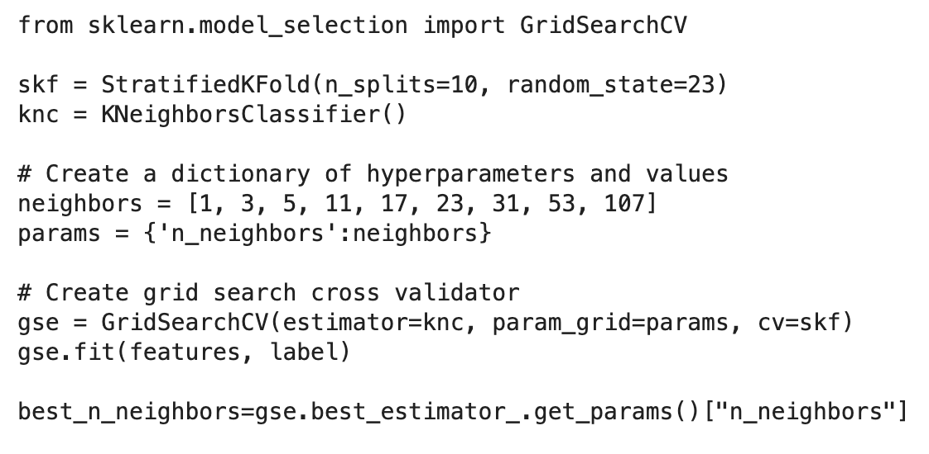
Grid Search

Slide 18
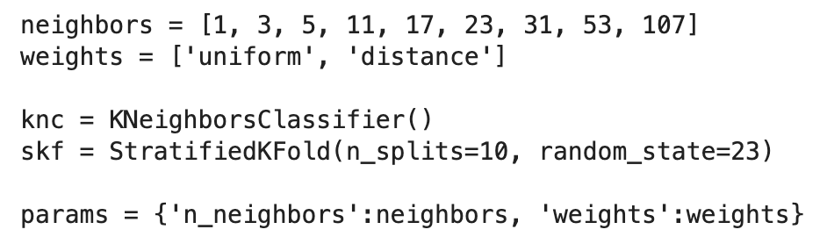
Multi-dimensional Grid Search

Slide 19
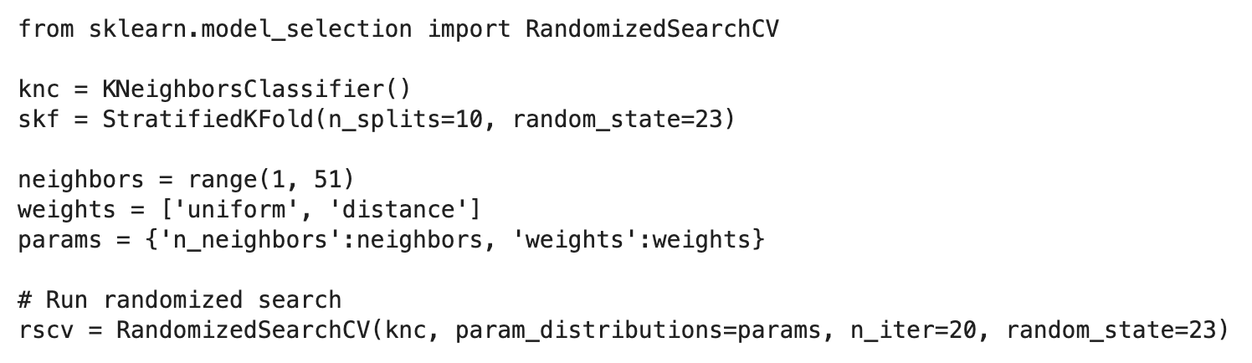
Randomized Grid Search

